Slide 1

Introduction to Computer Science
Day 2

Slide 2
The Building Blocks: Binary Numbers, Boolean Logic, and Gates

Slide 3
Introduction
This chapter explains how computers work
All computing devices are built on the ideas in this chapter:
Laptops, desktops
Servers, supercomputers
Game systems, cell phones, MP3 players
Calculators, singing get-well cards
Embedded systems in toys, cars, microwaves, etc.

Slide 4
The Binary Numbering System
How can an electronic (or magnetic) machine represent information?
Key requirements: clear, unambiguous, reliable
External representation is human-oriented
Base-10 numbers
Keyboard characters
Internal representation is computer-oriented
Base-2 numbers
Base-2 codes for characters

Slide 5
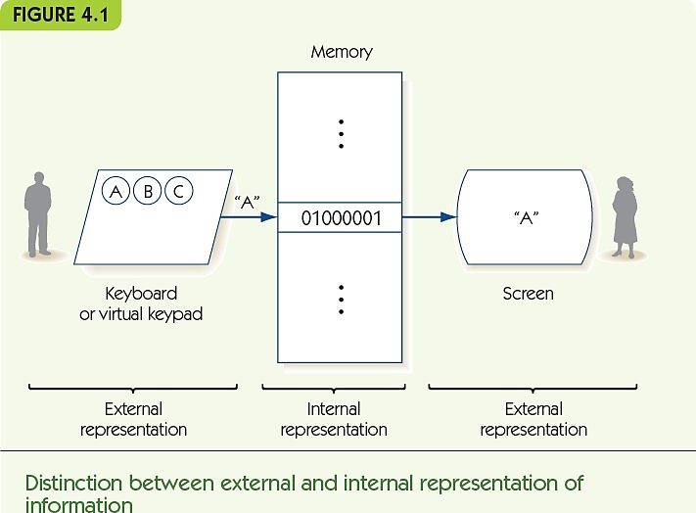

Slide 6
The Binary Numbering System (cont'd)
The binary numbering system is a base-2 positional numbering system
Base ten:
Uses 10 digits: 0, 1, 2, 3, 4, 5, 6, 7, 8, 9
Each place corresponds to a power of 10
1,943 = 1 * 10³ + 9 * 10² + 4 * 10¹ + 3 * 10⁰
Base two:
Uses 2 digits: 0, 1
Each place corresponds to a power of 2
1101 = 1 * 2³ + 1 * 2² + 0 * 2¹ + 1 * 2⁰ = 13
Why do humans use the Base-10 numbering system?

Slide 7
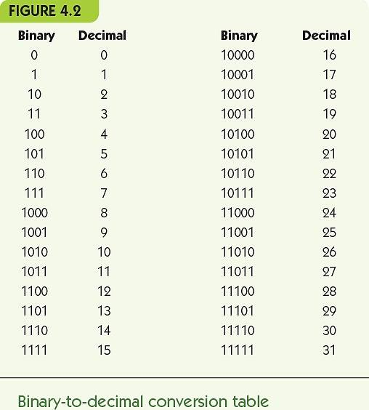

Slide 8
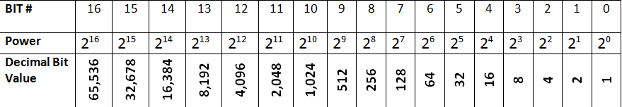
The Binary Numbering System (cont'd)
Converting from binary to decimal
Add up powers of two where a 1 appears in the binary number
Try it: 1001
1 in the 2³ power position, decimal bit value = 8
1 in the 2⁰ power position, decimal bit value = 1
8 + 1 = 9

Slide 9
The Binary Numbering System (cont'd)
Converting from binary to decimal
Add up powers of two where a 1 appears in the binary number
Try it: 10100
1 in the 2⁴ power position, decimal bit value = 16
1 in the 2² power position, decimal bit value = 4
16 + 4 = 20

Slide 10
The Binary Numbering System (cont'd)
Converting from decimal to binary
Repeatedly divide by two and record the remainder
Example, convert 9:
9/2 = 4 remainder 1, binary number = 1
4/2 = 2 remainder 0, binary number = 01
2/2 = 1 remainder 0, binary number = 001
1/2 = 0 remainder 1, binary number = 1001
Example, convert 23:
23/2 = 11 remainder 1, binary number = 1
11/2 = 5 remainder 1, binary number = 11
5/2 = 2 remainder 1, binary number = 111
2/2 = 1 remainder 0, binary number = 0111
1/2 = 0 remainder 1, binary number = 10111

Slide 11
The Binary Numbering System (cont'd)
Computers use fixed-length binary numbers for integers, e.g., with 4 bits could represent 0 to 15
Arithmetic overflow: when the computer tries to make a number that is too large, e.g. 14 + 2 with 4 bits
Binary addition:
0+0=0
0+1=1
1+0=1
1+1=0 with carry of 1
Example: 0101 + 0011 = 1000
Example: 01 + 11 = 100

Slide 12
The Binary Numbering System (cont'd)
Signed integers include negative numbers
Sign/magnitude notation uses 1 bit for the sign, the rest for the value.
A ZERO represents a positive sign, a 1 for negative
+5 = 0101, -5 = 1101
0 = 0000 and 1000!
Two’s complement representation: to make the negative of a number, flip every bit and add one
+5 = 0101, -5 = 1010 + 1 = 1011
0 = 0000, -0 = 1111 + 1 = 0000

Slide 13
The Binary Numbering System (cont'd)
Floating point numbers use binary scientific notation
Scientific notation, base 10: 1.35 × 10⁻⁵
Base 2: 3.25₁₀ = 11.01₂ = 1.101 × 2¹
Numbers to the right of the binary point represent halves, quarters, eighths etc.
Characters and text: map characters onto binary numbers in a standard way
ASCII (8-bit numbers for each character)
Unicode (16-bit numbers for each character)

Slide 14
ASCII - American Standard Code for Information Interchange
ASCII is a character encoding based on the English alphabet. (created in 1960)
ASCII codes represent text in computers, communications equipment, and other devices that work with text.
It currently defines codes for 128 characters:
33 are non-printing, mostly obsolete control characters that affect how text is processed, and 95 are printable characters.
Bookmark it!! – www.ascii-code.net

Slide 15
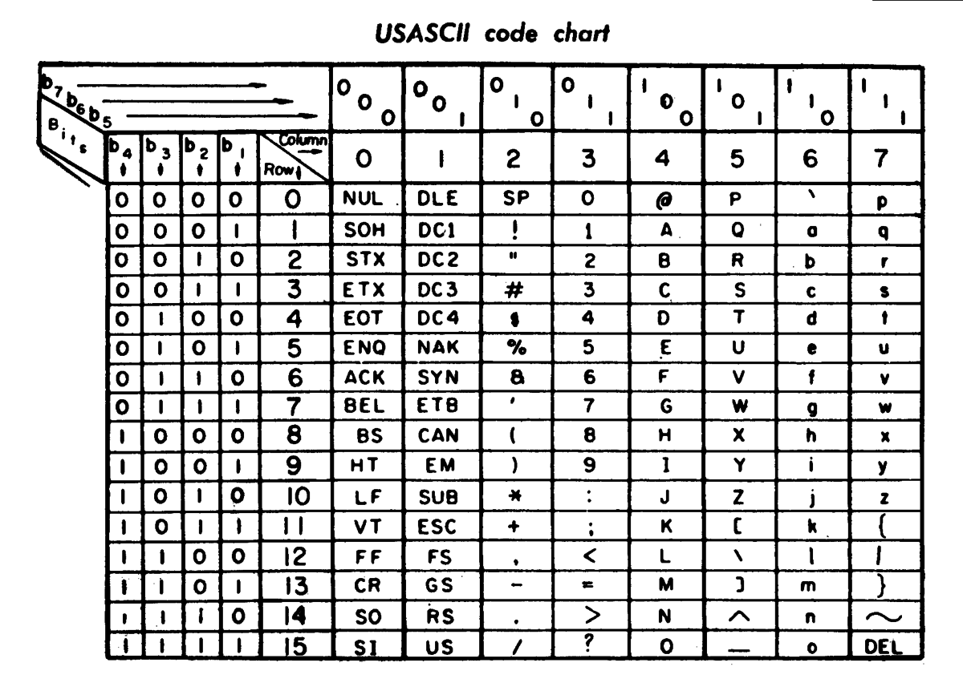
ASCII Code Chart
http://en.wikipedia.org/wiki/ASCII

Slide 16
The Binary Numbering System (cont'd)
Sounds and images require converting naturally analog representations to digital representations
Sound waves characterized by:
Amplitude: height of the wave at a moment in time
Period: length of time until wave pattern repeats
Frequency: number of periods per time unit

Slide 17
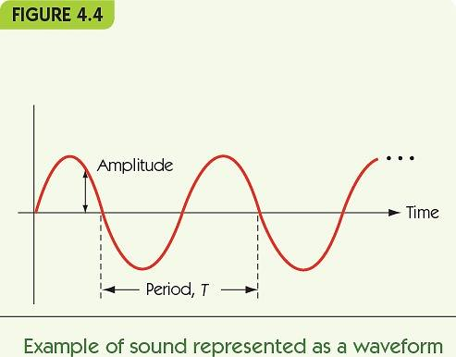

Slide 18
The Binary Numbering System (cont'd)
Image sampling: record color or intensity at fixed, discrete intervals in two dimensions
Pixels: individual recorded samples
RGB encoding scheme:
Colors are combinations of red, green, and blue
One byte each for red, green, and blue
Raster graphics store picture as two-d grid of pixel values

Slide 19
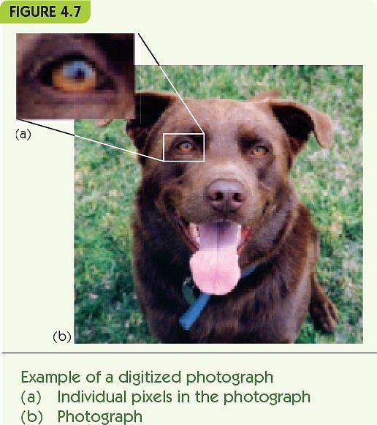

Slide 20
The Binary Numbering System (cont'd)
Data size: how much to store
1000 integer values
10-page text paper
60-second sound file
480 by 640 image
Data compression: storing data in a reduced-size form to save space/time
Lossless: data can be perfectly restored
Lossy: data cannot be perfectly restored

Slide 21
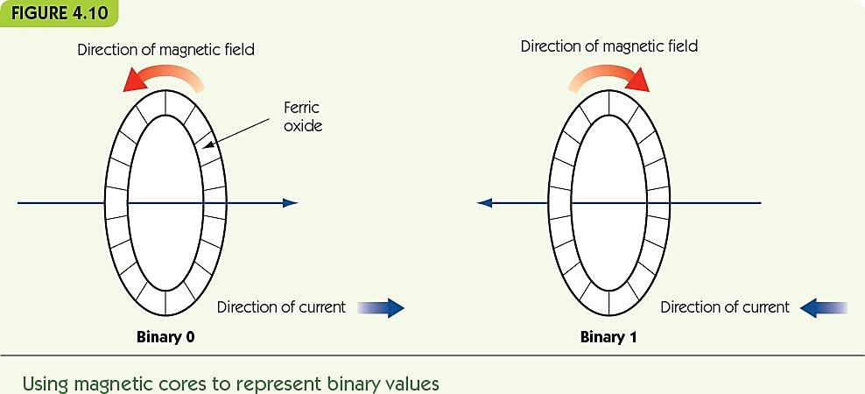
The Binary Numbering System (cont'd)
Computers use binary because “bistable” systems are reliable
Current on/off
Magnetic field left/right

Slide 22
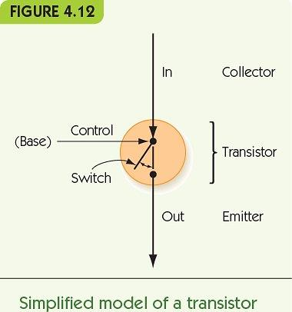
The Binary Numbering System (cont'd)
Transistors
Solid-state switches
Change on/off when given power on control line
Extremely small (billions per chip)
Enable computers that work with gigabytes of data

Slide 23
Boolean Logic and Gates
Boolean logic: rules for manipulating true/false
Boolean expressions can be converted to circuits
Hardware design/logic design pertains to the design and construction of new circuits
Binary 1/0 maps to true/false of Boolean logic

Slide 24
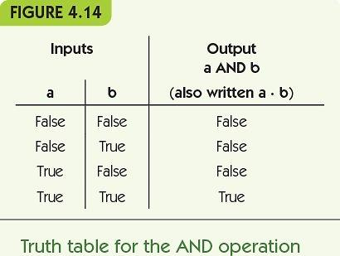
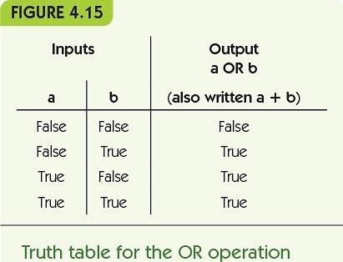
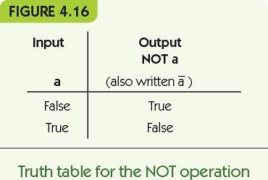

Slide 25
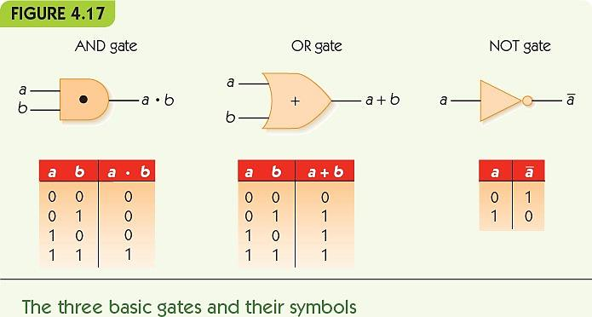
Boolean Logic and Gates (cont'd)
Gate: an electronic device that operates on inputs to produce outputs
Each gate corresponds to a Boolean operator

Slide 26
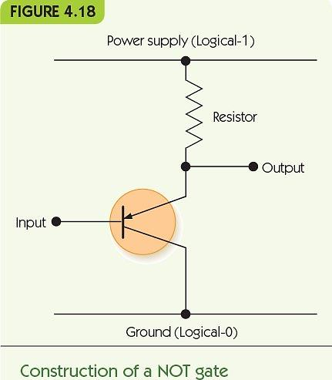
Boolean Logic and Gates (cont'd)
Gates are built from transistors
NOT gate: 1 transistor
AND gate: 3 transistors
OR gate: 3 transistors
NAND and NOR: 2 transistors

Slide 27
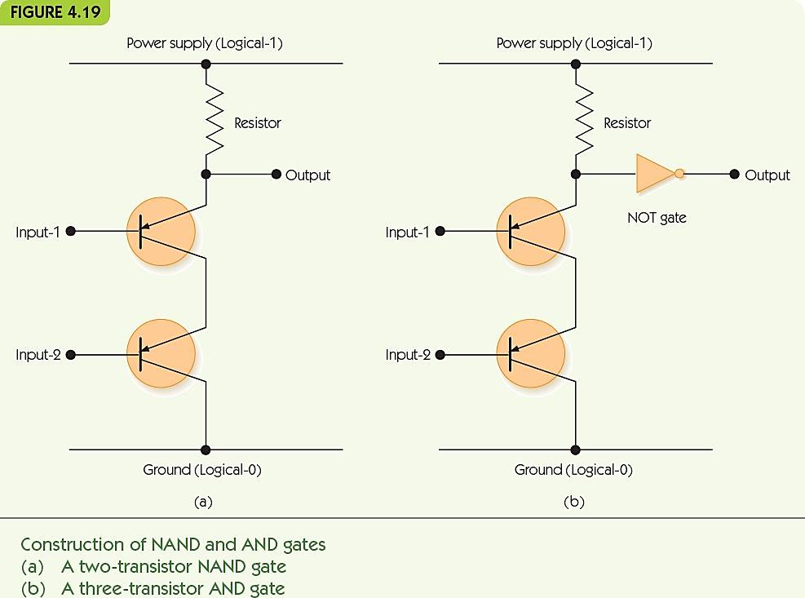

Slide 28
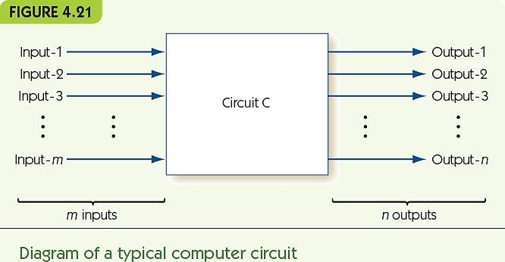
Building Computer Circuits
Circuit: has input wires, contains gates connected by wires, and has output wires
Outputs depend only on current inputs: no state

Slide 29
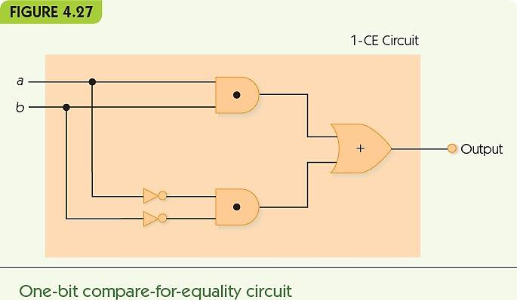
Building Computer Circuits (cont'd)
Compare-for-equality (CE) circuit
Input is two unsigned binary numbers
Output is 1 if inputs are identical, and 0 otherwise
Start with one-bit version (1-CE) and build general version from that

Slide 30
Control Circuits
Control circuits make decisions, determine order of operations, select data values
Multiplexor selects one from among many inputs
2^{N} input lines
N selector lines
1 output line
Each input line corresponds to a unique pattern on selector lines
That input value is passed to output

Slide 31
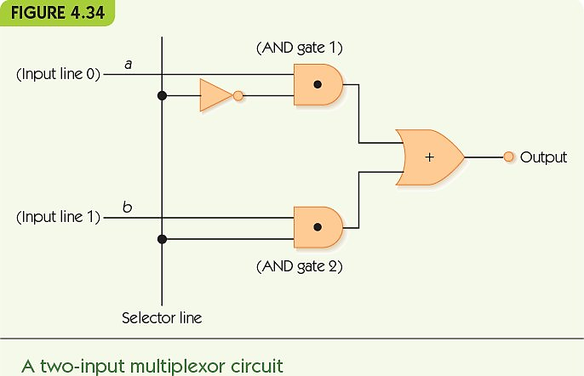

Slide 32
Control Circuits (cont'd)
Decoder sends a signal out only one output, chosen by its input
N input lines
2^{N} output lines
Each output line corresponds to a unique pattern on input lines
Only the chosen output line produces 1, all others output 0

Slide 33
Control Circuits (cont'd)
Decoder circuit uses
To select a single arithmetic instruction, given a code for that instruction
Code activates one output line; that line activates corresponding arithmetic circuit
Multiplexor circuit uses
To choose one data value from among a set, based on selector pattern
Many data values flow into the multiplexor, only the selected one comes out

Slide 34
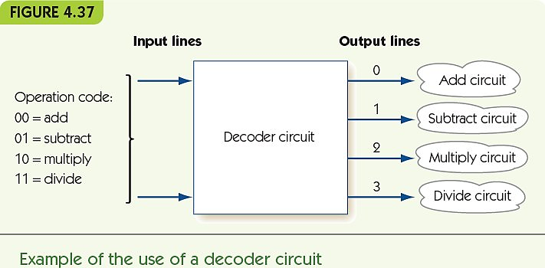

Slide 35
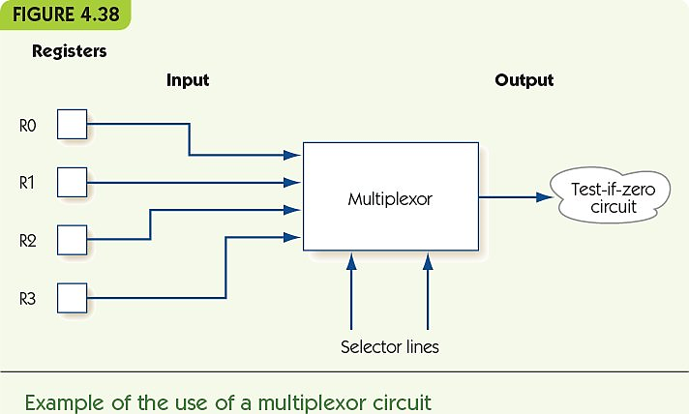

Slide 36
Exercises
Determine the decimal value of the following unsigned numbers:
11000
110001
1111111
1000000000
Using 8 bits, what is the unsigned binary representation of each of the following values?
23
55
275
Using the ASCII code set, show the internal binary representation of the following character strings:
AbC
Mike
$25.00
(a+b)

Slide 37
Chapter 5
Computer Systems Organization

Slide 38
The Components of a Computer System
Von Neumann architecture
Foundation for nearly all modern computers
Characteristics
Central Processing Unit (CPU)
Memory
Input/output
Arithmetic/logic unit
Control unit
Stored program concept
Sequential execution of instructions

Slide 39
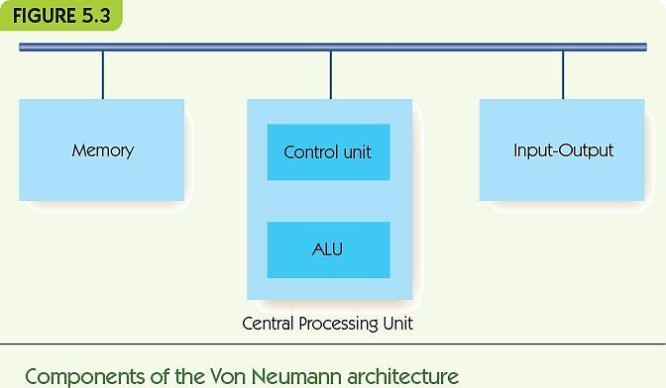

Slide 40
The Components of a Computer System Memory and Cache (cont'd)
Memory: functional unit where data is stored/retrieved
Random access memory (RAM)
Organized into cells, each given a unique address
Equal time to access any cell
Cell values may be read and changed
Cell size/memory width is typically 8 bits
Maximum memory size/address space is 2^{N}, where N is length of address

Slide 41
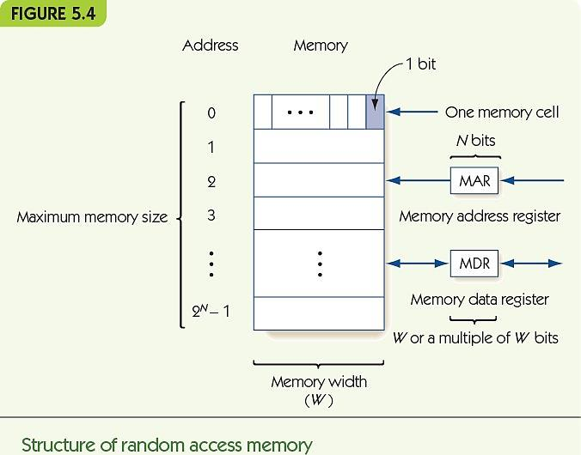

Slide 42
Memory and Cache (cont'd)
Fetch: retrieve from memory (nondestructive fetch)
Store: write to memory (destructive store)
Memory access time
Time required to fetch/store
Modern RAM requires 5-10 nanoseconds
MAR (Memory Address Register) holds memory address to access
MDR (Memory Data Register) receives data from fetch, holds data to be stored

Slide 43
Memory and Cache (cont'd)
Memory system circuits: decoder and fetch/store controller
Decoder converts MAR into signal to a specific memory cell
One-dimensional versus two-dimensional memory organization
Fetch/Store controller ► traffic cop for MDR
Takes in a signal that indicates fetch or store
Routes data flow to/from memory cells and MDR

Slide 44
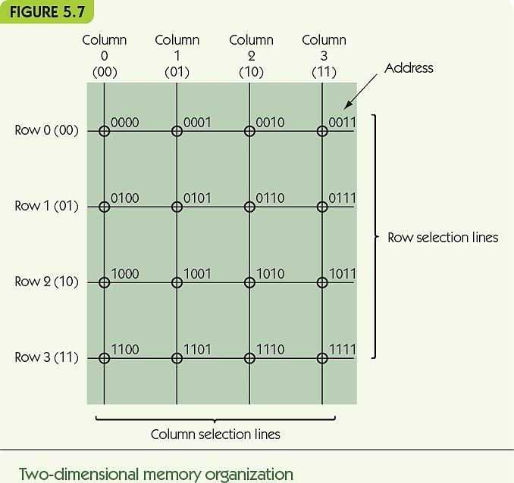

Slide 45
Memory and Cache (cont'd)
RAM speeds increased more slowly than CPU speeds
Cache memory is fast but expensive
Principle of locality
Values close to recently-accessed memory are more likely to be accessed
Load neighbors into cache and keep recent values there
Cache hit rate: percentage of times values are found in cache

Slide 46
Input/Output and Mass Storage
Input/output (I/O) connects the processor to the outside world
Humans: keyboard, monitor, etc.
Data storage: hard drive, DVD, flash drive
Other computers: network
RAM = volatile memory (gone without power)
Mass storage systems = nonvolatile memory
Direct access storage devices (DASDs)
Sequential access storage devices (SASDs)

Slide 47
The Components of a Computer System I/O and Mass Storage (cont'd)
DASDs
Hard drives, CDs, DVDs contain disks
Tracks: concentric rings around disk surface
Sectors: fixed size segments of tracks, unit of retrieval
Time to retrieve data based on:
Seek time
Latency
Transfer time
Other non-disk DASDs: flash memory, optical

Slide 48
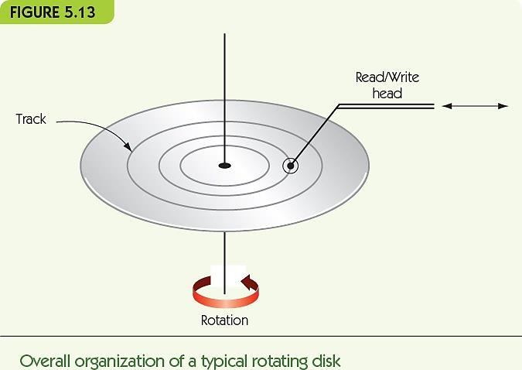

Slide 49
I/O and Mass Storage (cont'd)
DASDs and SASDs are orders of magnitude slower than RAM: (microseconds or milliseconds)
I/O Controller manages data transfer with slow I/O devices, freeing processor to do other work
Controller sends an interrupt signal to processor when I/O task is done

Slide 50
The Arithmetic/Logic Unit
ALU is part of the processor
Contains circuits for arithmetic:
Addition, subtraction, multiplication, and division
Contains circuits for comparison and logic:
Equality, and, or, not
Contains registers: super-fast, dedicated memory connected to circuits
Data path: how information flows in ALU
From registers to circuits
From circuits back to registers

Slide 51
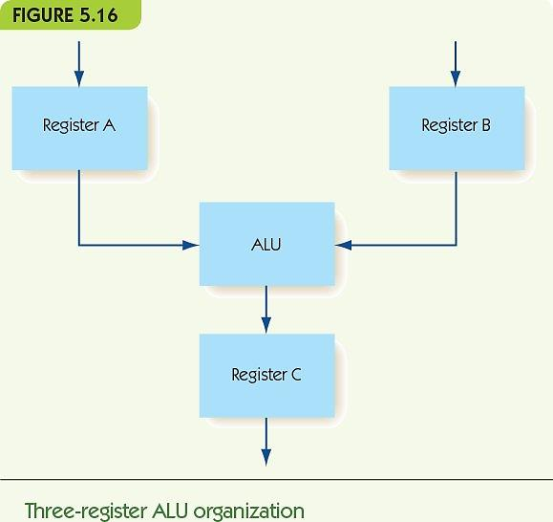

Slide 52
The ALU (cont'd)
How is the operation to perform chosen?
Option 1: decoder signals one circuit to run
Option 2: run all circuits, multiplexor selects one output from all circuits
In practice, option 2 is usually chosen
Information flow
Data comes in from outside ALU to registers
Signal comes to multiplexor, which operation
Result goes back to register, and then to outside

Slide 53
The Control Unit
Stored program characteristic
Programs are encoded in binary and stored in computer’s memory
Control unit fetches instructions from memory, decodes them, and executes them
Instructions encoded
Operation code (op code) tells which operation
Addresses tell which memory addresses/registers to operate on
Machine language
Binary strings that encode instructions
Instructions can be carried out by hardware
Sequences of instructions encode algorithms
Instruction set
The instructions implemented by a particular chip
Each kind of processor speaks a different language

Slide 54
Non-Von Neumann Architectures
Problems to solve are always larger
Computer chip speeds no longer increase exponentially
Reducing size puts gates closer together, faster
Speed of light pertains to signals through wire
Cannot put gates much closer together
Heat production increases too fast
Von Neumann bottleneck: inability of sequential machines to handle larger problems

Slide 55
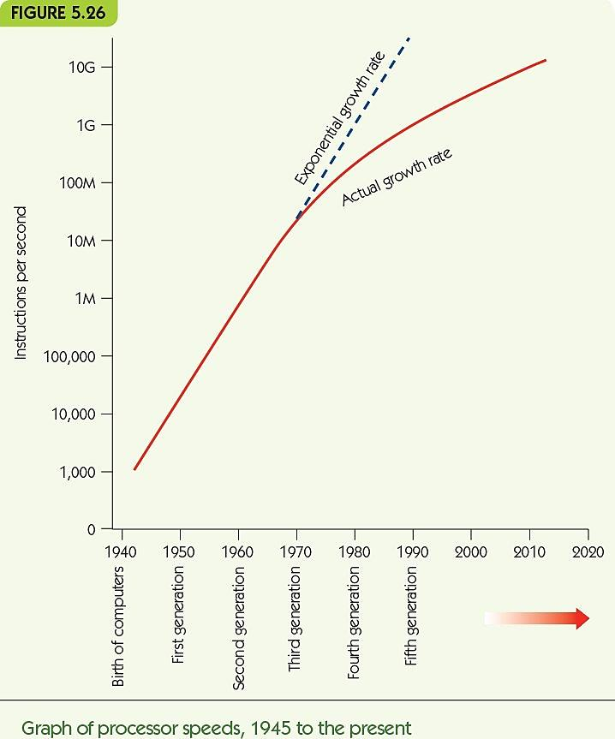

Slide 56
Non-Von Neumann Architectures (cont'd)
Non-Von Neumann architectures
Other ways to organize computers
Most are experimental/theoretical, EXCEPT parallel processing
Parallel processing
Many processing units operating at the same time
Supercomputers (in the past)
Desktop multi-core machines (in the present)
“The cloud” (in the future)

Slide 57
Non-Von Neumann Architectures (cont'd)
MIMD parallel processing
Multiple Instruction stream/Multiple Data streams
Cluster computing
Multiple, independent processors
Each ALU operates on its own data
Each processor can operate independently:
On its own data
On its own program
At its own rate

Slide 58
Non-Von Neumann Architectures (cont'd)
Varieties of MIMD systems
Special-purpose systems: newer supercomputers
Cluster computing: standard machines communicating over LAN or WAN
Grid computing: machines of varying power, over large distances/Internet
Example: SETI project
Hot research area ► parallel algorithms
Need to take advantage of all this processing power

Slide 59
Summary
Von Neumann architecture is standard for modern computing
Von Neumann machines have memory, I/O, ALU, and control unit; programs are stored in memory; execution is sequential unless program says other
Memory is organized into addressable cells; data is fetched and stored based on MAR and MDR; uses decoder and fetch/store controller
Mass data storage is nonvolatile; disks store and fetch sectors of data stored in tracks
I/O is slow, needs dedicated controller to free CPU
ALU performs computations, moving data to/from dedicated registers
Control unit fetches, decodes, and executes instructions; instructions are written in machine language
Parallel processing architectures can perform multiple instructions at one time

Slide 60
Chapter 6
An Introduction to System Software and Virtual Machines

Slide 61
Why do we need Software?
A naked machine has no tools or programs to help the user:
Write instructions in binary
Write data in binary
Load instructions into memory one cell at a time
Initiate program run
Too difficult for humans to do
We must build an interface to hide the details and make the computer easier to build

Slide 62
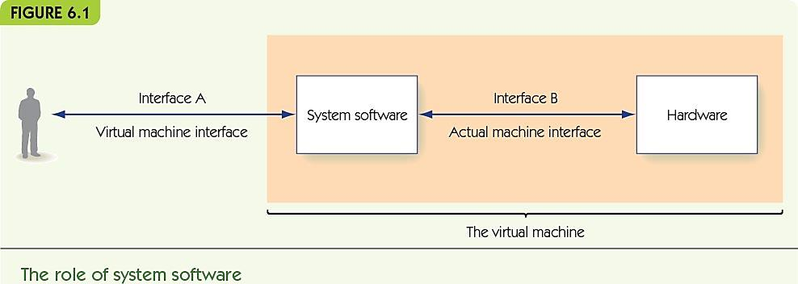
System Software
System software is a collection of programs to:
Manage resources of the computer
Serve as intermediary between user and hardware
System software creates a virtual machine (or virtual environment) that user sees

Slide 63
System Software (cont'd)
Operating system: central system software
Communicates with users
Starts up other system software and applications as needed
Graphical user interface (GUI), often pronounced gooey
Visual interface to operating system (or other system software/applications)
I/O systems communicate with various devices

Slide 64
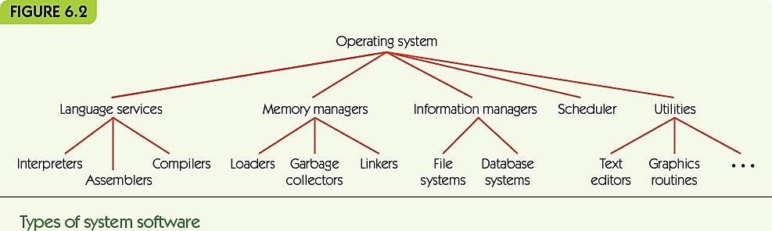
System Software (cont'd)
Language services support high level languages
Memory managers allocate memory to programs
Information managers organize mass storage
Scheduler manages programs waiting to run
Utilities: tools, including program libraries

Slide 65
System Software (cont'd)
Naked machine
Write program in binary
Load instructions one-by-one into memory
Insert start into memory address 0 and push “go” button
Read results from memory one-by-one, in binary
Virtual machine
Write program using text editor in high-level language
Save program to folder
Use translator to convert to binary
Use scheduler to load and run
Use I/O system to print results

Slide 66
Assemblers and Assembly Language
Assembly language
Instructions map one-to-one to machine language
Symbolic op codes (not binary)
Symbolic addresses for instructions and data
Pseudo-ops for data generation and more (data in human-friendly terms)
Assembly ► a low-level programming language
Java, C, Python ► high-level programming languages

Slide 67
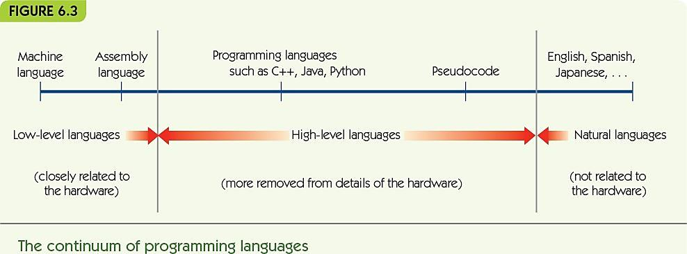

Slide 68
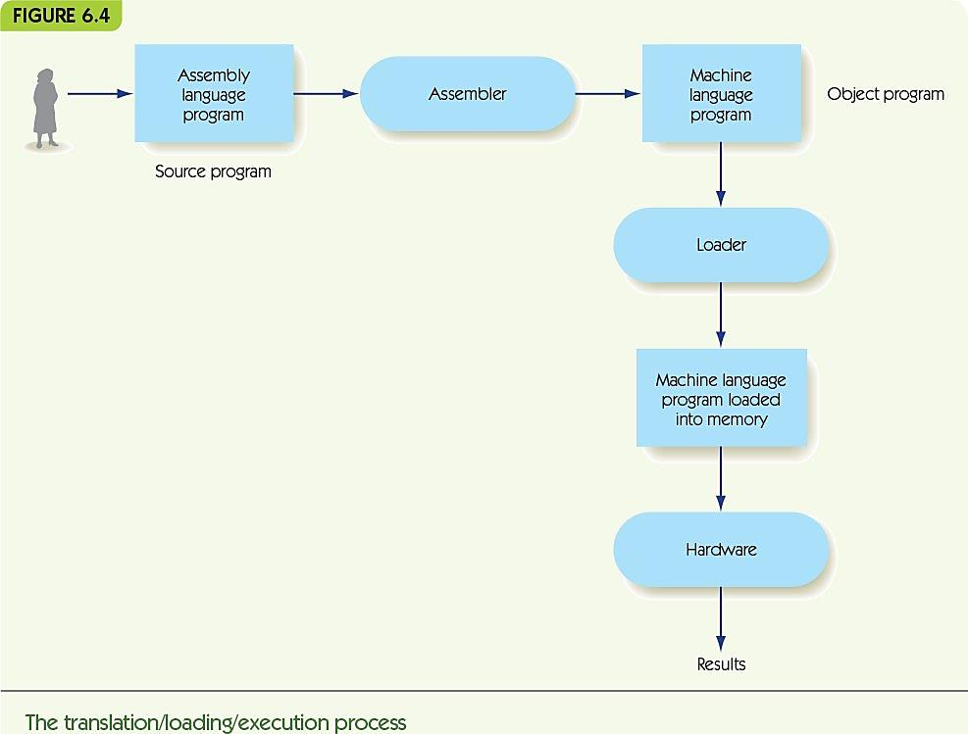
Assemblers and Assembly Language (cont'd)
Assembly language process
Source program (assembly language)
Translated by the assembler to
Object program (machine language)
Loader places in memory
Hardware runs

Slide 69
Assemblers and Assembly Language (cont'd)
Simple examples:
x = y + 3
input a and b
while a > b do
print a
a = a – 2
LOAD Y
ADD THREE
STORE X
… -- Data comes after .END
X: .DATA 0 -- X is initially 0
Y: .DATA 5 – Y is initially 5
THREE: .DATA 3 –The constant 3
IN A
IN B
LOOP1: LOAD A A: .DATA 0
COMPARE B B: .DATA 0
JUMPLT LOOP1END TWO: .DATA 2
JUMPEQ LOOP1END
OUT A
LOAD A
SUBTRACT TWO
STORE A
JUMP LOOP1
LOOP1END: …

Slide 70
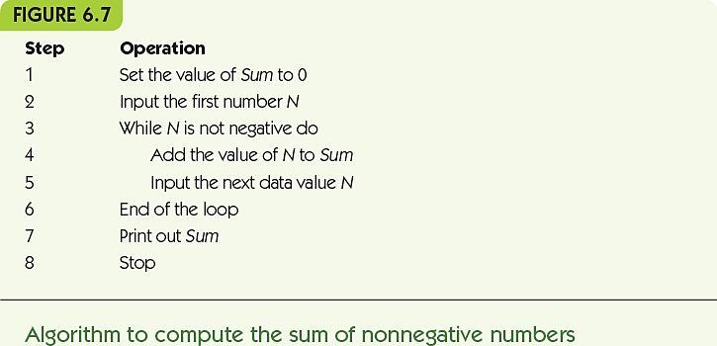
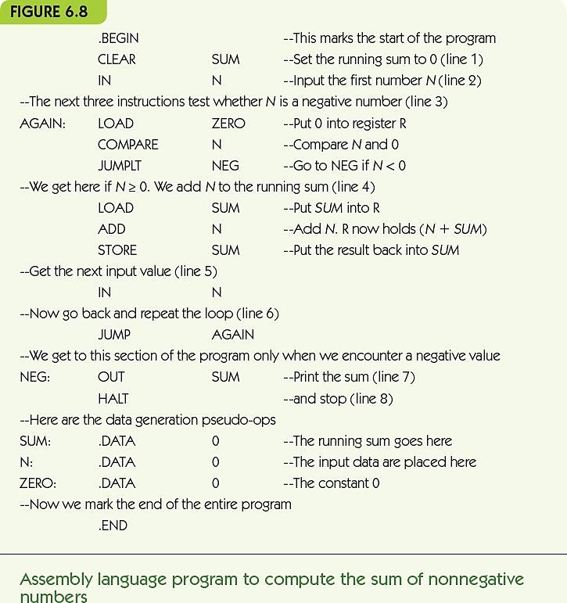

Slide 71
Assemblers and Assembly Language (cont'd)
Translation and loading
Assembler translates to machine language
Converts symbolic op codes to binary equivalents
Converts symbolic labels to memory addresses
Performs pseudo-op actions
Writes object file containing machine instructions
Loader gets program ready to run
Places instructions in memory
Triggers the hardware to run the program

Slide 72
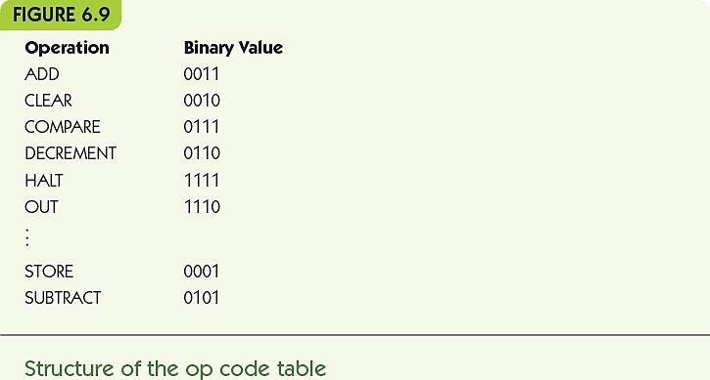
Assemblers and Assembly Language (cont'd)
Converting symbolic op codes to binary ones
Assembler maintains a table
Assembler looks up symbolic op codes in the table and substitutes the binary analogue
Use binary search to optimize table lookups

Slide 73
Assemblers and Assembly Language (cont'd)
Converting symbolic labels to memory addresses
Assembler needs two passes
Looks over assembly code two times
First pass
Keeps a count of how many instructions from the start
Collects symbolic labels and add to symbol table along with location counter
Second pass
Looks up and replace op codes
Substitutes label references with location from symbol table
Sets up .DATA pseudo-ops with location and binary value
Writes instructions to object file

Slide 74
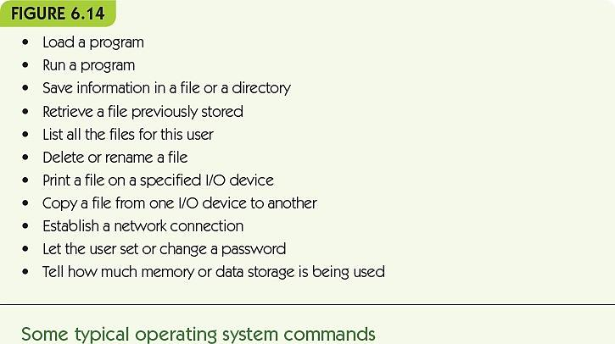
Operating Systems
System commands: user instructions about what the computer should do

Slide 75
Operating Systems (cont'd)
User interface: user communicates with operating system
Operating system as receptionist and dispatcher
User command→system software scheduled and run→repeat
Text-based
System commands typed at a prompt in a terminal
Command language must be learned
GUI-based
System commands by a visual/mouse interface

Slide 76
Operating Systems (cont'd)
System security and protection: permit only authorized access to resources
Operating system as a security guard
Access protected by usernames and passwords
Superusers have more privileges
Encrypt data to increase security
Folders and files have authorization lists
Read a file, add new information to a file, change existing information, and delete a file

Slide 77
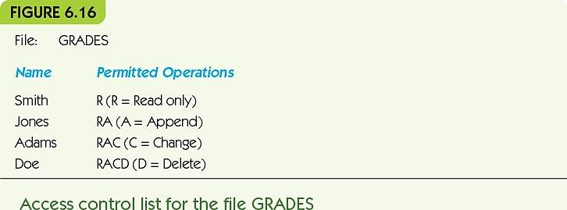

Slide 78
Operating Systems (cont'd)
Efficient allocation of resources: keep the CPU busy and all programs making progress
Operating system as traffic cop
Multiple programs active at one time
Every program is in one of three states:
Running: program currently using the CPU
Waiting: programs waiting for I/O operations to complete
Ready: programs ready for a turn on CPU
Keep a queue of ready programs and share

Slide 79
Operating Systems (cont'd)
Safe use of resources: ensure that the computer doesn’t get stuck in deadlock
Multiple programs requesting access to resources
Deadlock occurs when all programs have some resources, and are waiting for resources held by others
Deadlock prevention: if you can’t get all resources, release all you have and try again later
Deadlock recovery: if no acknowledgement, send message again

Slide 80
Operating Systems (cont'd)
Historical development of operating systems
First generation: nearly “naked computer”
Programmer hand-loaded programs
Second generation: batch operating system
Programmers gave programs to operators
Operators collect a “batch” of programs
Used I/O computer to translate programs to tape
Ran programs as a group
Used I/O computer to translate output to text/paper
Job control language: instructions to OS

Slide 81
Operating Systems (cont'd)
Third generation: multiprogrammed operating systems
Multiple programs loaded at once
Switch between programs when I/O happens
Computer security now required!
Privileged operations only available to the administrator
Bound memory a program can legitimately access

Slide 82
Operating Systems (cont'd)
Time-sharing system (also third generation)
Multiprogrammed, but users are on the system interactively
Users need an illusion of sole access
Allocate run time in time slices—each program runs until I/O OR time runs out

Slide 83
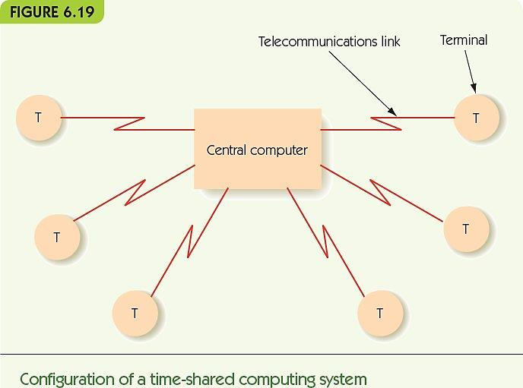

Slide 84
Operating Systems (cont'd)
Fourth generation: network operating system
Operating system supports all the same local services
Also supports services that access resources that are available over a network
Shared printer
Servers: email, data, web
Connections to the Internet
Real-time operating system or embedded system are special-purpose computers in other equipment

Slide 85
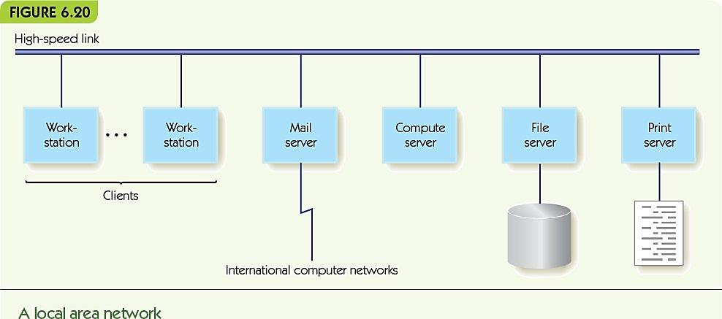
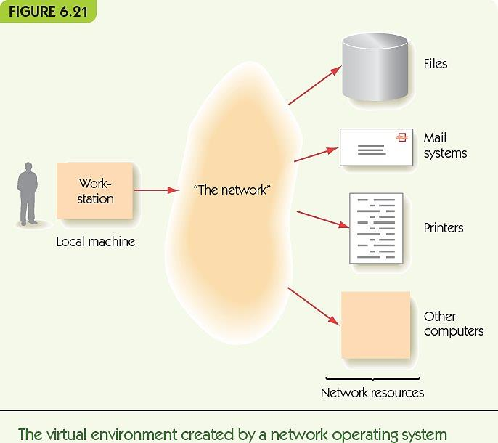

Slide 86
Operating Systems (cont'd)
Fifth generation, the near future
Multimedia interfaces (integrate images, speech, video seamlessly)
Parallel processing system to perform multimedia and to permit larger scale tasks
Distributed computing environment in which users don’t know where resources are stored
Cloud computing

Slide 87
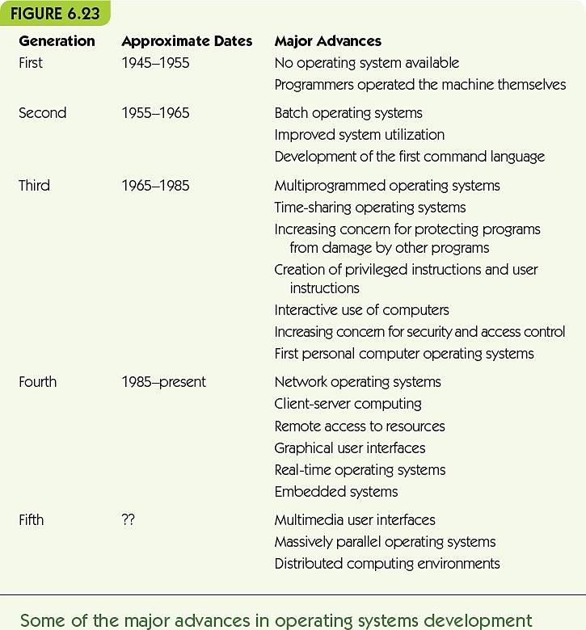

Slide 88
Summary
System software creates a virtual machine that is easy for users to use
Assemblers and loaders are system software: translate human-friendly programs to machine language
Assembly language uses symbolic names, symbolic op codes, and pseudo-ops to describe algorithms
Assembler translates source programs to object files; loader places object instructions in memory

Slide 89
Summary (cont'd)
Operating systems communicate with users through text or GUI actions
The operating system includes key tasks such as: the user interface, system security, scheduling of programs, and system safety
Operating systems developed through four generations of improvements, each adding new features and improving efficiency
Future operating systems: parallel, distributed, and multimedia, with resources stored remotely

Slide 90
Chapter 7
Computer Networks and Cloud Computing

Slide 91
Why do we need computer networks?
Computer networks have had revolutionary impact
Electronic commerce
Worldwide communications
Spread of information and data
We take for granted:
Access to information on any subject
Immediate contact with people around the world
Streaming audio and video
Wired or wireless access from every device

Slide 92
Basic Networking Concepts
Computer network is made up of computing devices, nodes, and interconnections
Networks may be wired or wireless; communication links use various technology
Wired networks
Dial-up
Broadband
Wireless networks
WLAN, WWAN, MAN, LAN, PAN

Slide 93
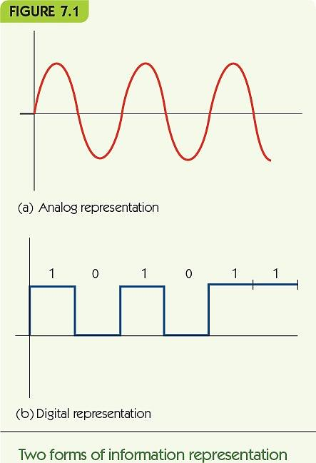
Basic Networking Concepts (cont'd.)
Switched, dial-up telephone lines
Analog lines
Transmit digital data
Modem modulates carrier wave
Speeds up to 56k bps
Bandwidth = capacity

Slide 94
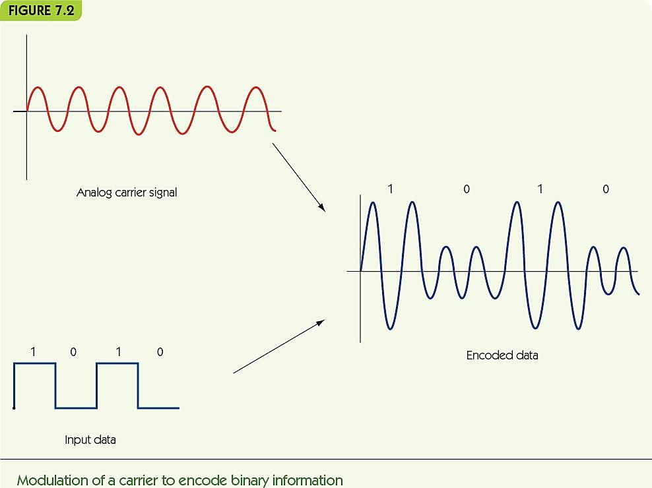

Slide 95
Basic Networking Concepts (cont'd.)
Broadband provides transmission rate > 256k bps
Home Internet connections
Asymmetric download/upload times
Digital subscriber line (DSL)
Uses phone lines, but sends digital signal on different frequencies than voice
Download rate: 5-50 Mbps; Upload rate: 1-5 Mbps
Cable modem
Uses cable TV lines

Slide 96
Basic Networking Concepts (cont'd.)
Commercial/institutional Internet connections
Ethernet (1970s)
Dedicated coaxial cable
Operates at 10 Mbps
Fast Ethernet (early 1990s)
Dedicated lines (coaxial, fiber-optic, or twisted-pair)
Operates at 100 Mbps
Gigabit Ethernet Standard (late 1990s)
From gigabit networking research project
IEEE standard
Operates at 1000 Mbps

Slide 97
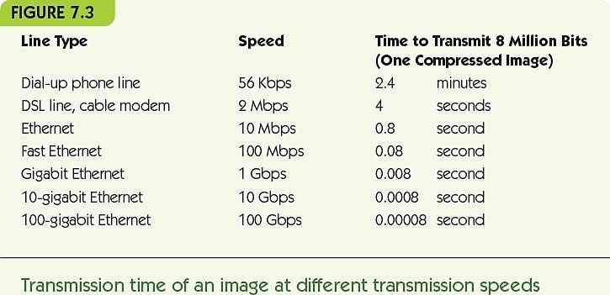

Slide 98
Basic Networking Concepts (cont'd.)
Wireless data communication
Radio, microwave, or infrared signals to mobile computers
Laptops, tablet computers, smartphones, etc.
Mobile computing delivers data regardless of location
Bluetooth
Low-power, close range (30-50 feet), connects devices like wireless mice, cameras, video games

Slide 99
Basic Networking Concepts (cont'd.)
Wireless local area network (WLAN)
Computers transmit wirelessly to a base station which has a wired connection
Range of 150-300 feet
Terminology
Wi-Fi (Wireless Fidelity)
IEEE 802.11 wireless network standards
Wi-Fi hot spot: library, Hunter school campus, coffee shop, etc.
Metropolitan Wi-Fi (MAN) service: cities provide routers

Slide 100
Basic Networking Concepts (cont'd.)
Wireless wide area network (WWAN)
Computers transmit wirelessly to a remote base station which has a wired connection
Cellular technology involves antennas on towers miles apart
Example: 4G
Voice and data; transmits at 50-500 Mbps
Signal may be blocked when indoors
Errors with data transmission can slow performance
Security concerns - wireless signals are easy to intercept

Slide 101
Basic Networking Concepts (cont'd.)
Local Area Networks (LAN)
Wired connection
Computers, printers, and servers are in close proximity
Examples: same room, office building, or campus
Privately owned and operated
Topology: how computers are connected
Affects how they communicate

Slide 102
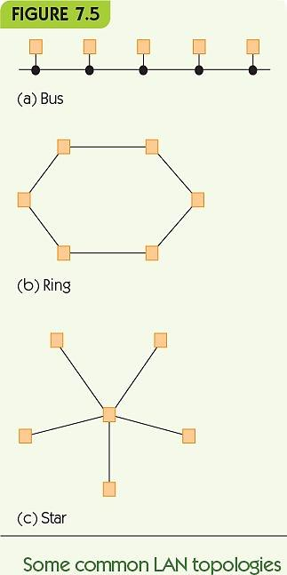
Basic Networking Concepts (cont'd.)
Bus topology
Shared lines
Devices take turns using the line
Ring topology
Messages circulate until they reach the source
Star topology
All messages are sent to a central node, which routes messages to their destinations

Slide 103
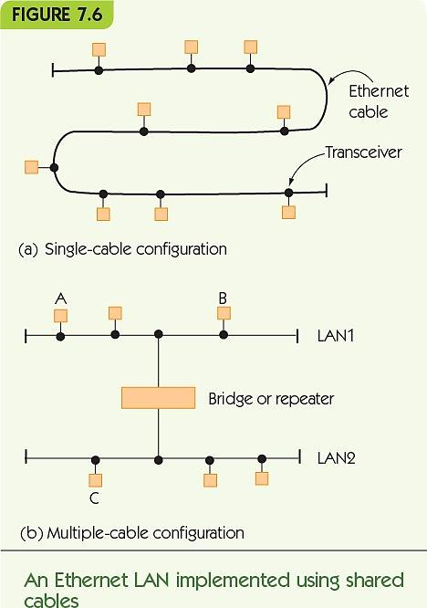
Basic Networking Concepts (cont'd.)
Ethernet LAN with shared cable
Bus topology
Single cable over short distances
Multiple cables over longer distances
Repeater amplifies the signal
Bridge routes messages only when necessary

Slide 104
Basic Networking Concepts (cont'd.)
Ethernet LAN with switch
Bus topology, still
Shared cable is inside the switch
Wiring closet contains switch and ports
Ethernet jacks in rooms connect to the switch in the closet
Wireless base stations also connect to the switch in the closet

Slide 105
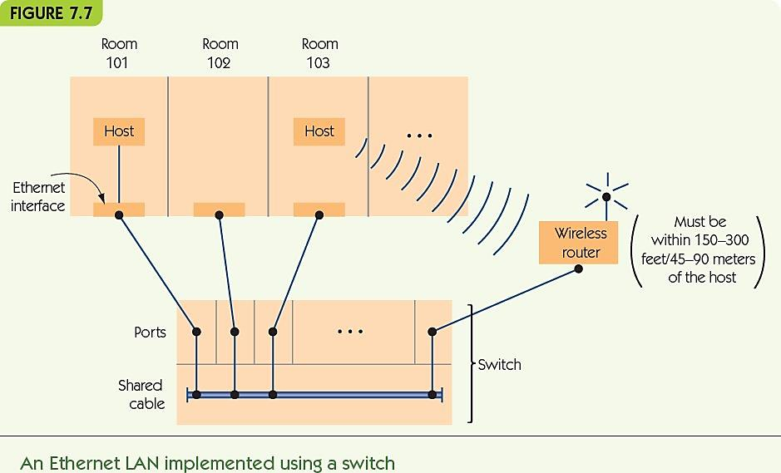

Slide 106
Basic Networking Concepts (cont'd.)
Wide Area Networks (WANs)
Wired connection
Connected computers - located at great distances
Examples: across state or country
Dedicated point-to-point lines
Computers connect to other computers on individual lines
Store-and-forward, packet-switched
Packets go from node to node until reaching their destination

Slide 107
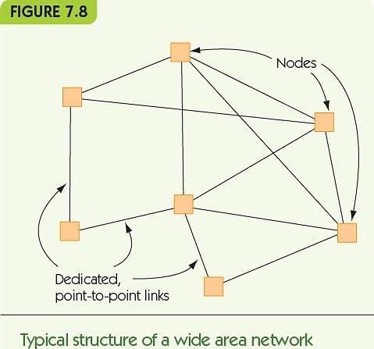

Slide 108
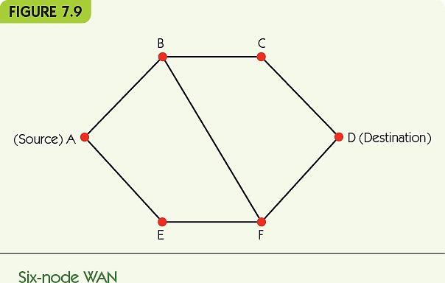
Basic Networking Concepts (cont'd.)
Routing of packets is determined dynamically
A-B-C-D or A-B-F-D or A-E-F-D or A-E-F-B-C-D
Redundant paths, fault tolerance, responsive to traffic load

Slide 109
Basic Networking Concepts (cont'd.)
Overall Structure of the Internet
Combination of LANs and WANs
Connected by routers that direct message traffic
Internet service provider (ISP) provides access to the Internet for private individuals and organizations
ISPs exist at multiple levels: local, regional, national, international (tier-1 network or Internet backbone)

Slide 110
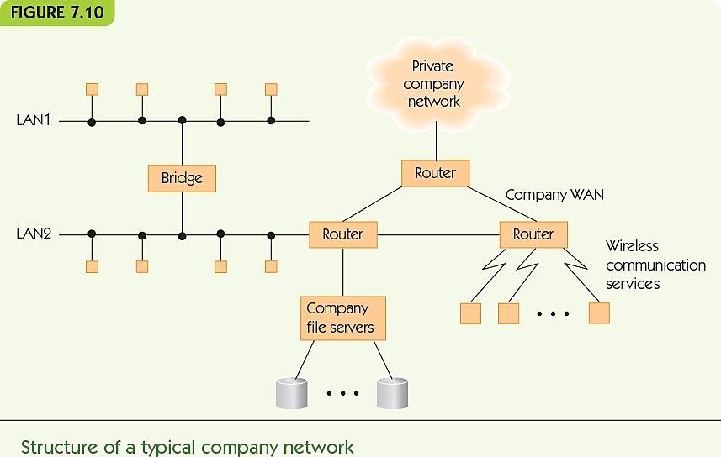

Slide 111
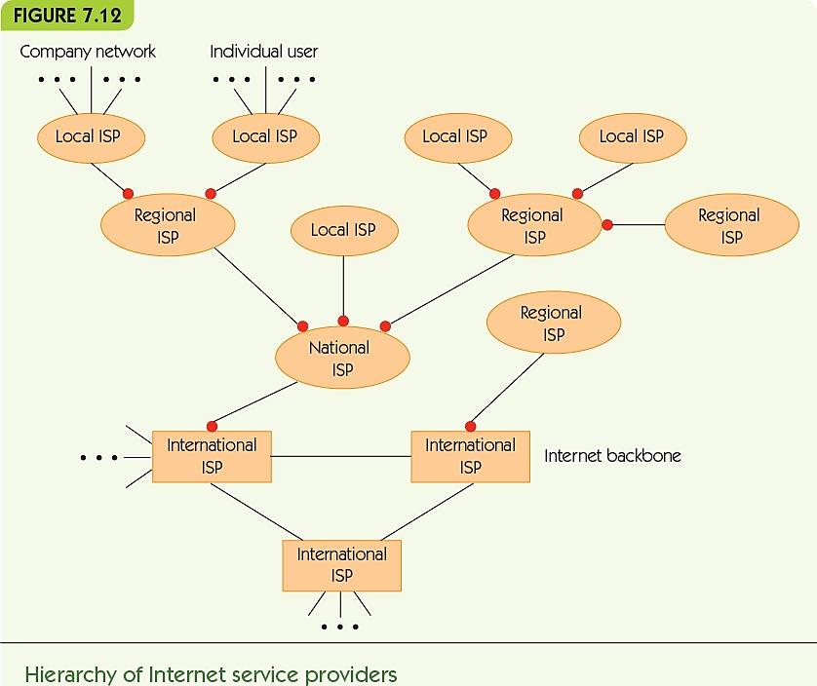

Slide 112
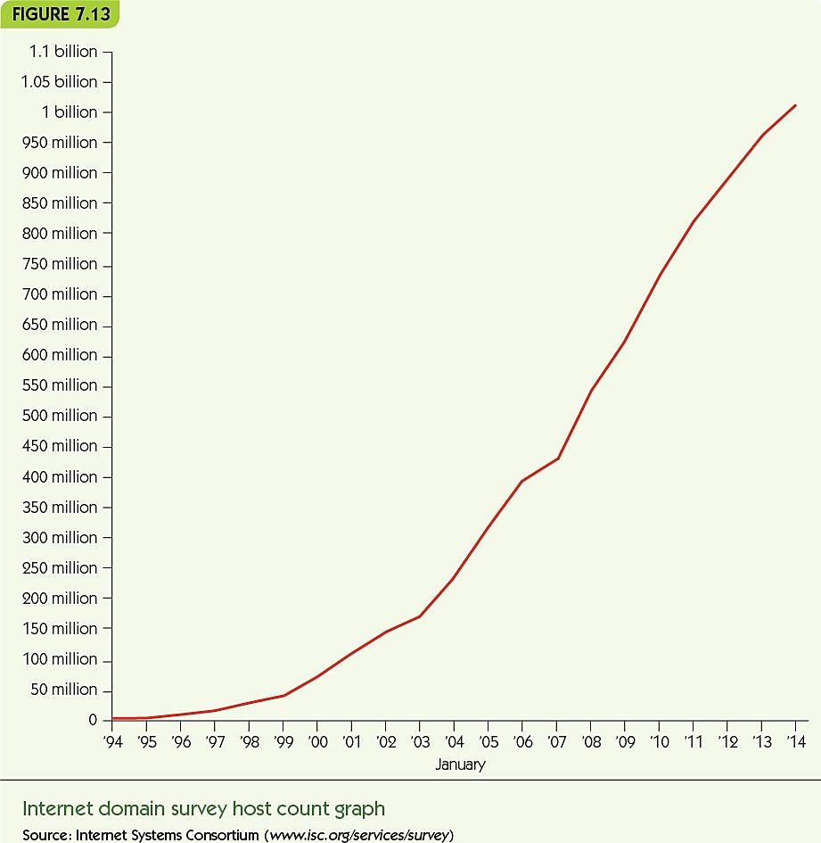
Basic Networking Concepts (cont'd.)
Internet growth has been astonishing

Slide 113
Communication Protocols
Protocol: a standard set of rules for communicating
Standards evolve over time
International agreements make Internet possible
Internet Society makes standards and promotes researchwww.isoc.org
Protocol hierarchy/protocol stack, TCP/IP
Layers of protocols
Physical transmission to end application rules and standards

Slide 114
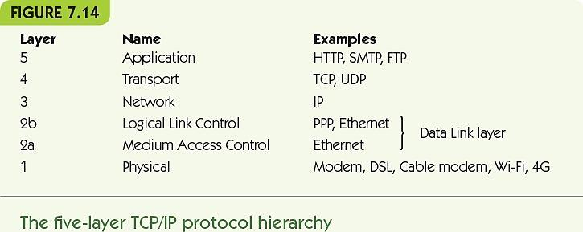

Slide 115
Communication Protocols: Physical Layer (cont'd.)
Physical layer protocols
Rules for exchanging binary data across a physical channel (fiber-optic, twisted-pair, wireless, etc.)
How to know when a bit is present on the line
How much time the bit will remain on the line
Whether the bit is digital or analog in form
What physical quantities represent 0 and 1
Shape of the connector between the computer and the transmission line
Create an abstract “bit pipe” used by higher layers

Slide 116


Slide 117
Communication Protocols: Data Link Layer (cont'd.)
Data Link protocols
Ensure reliable transmission of bits
Error detection and correction - notice failures in the transmission and fix them
Framing determines which bits belong to one message
Two parts
Layer 2a: Medium Access Control
Layer 2b: Logical Link Control

Slide 118
Communication Protocols: Data Link Layer (cont'd.)
Medium Access Control protocols
Rules for communicating on shared lines
Ethernet uses a contention-based protocol
When a node wants to send a message
Listen to the line and wait until it is free
Begin transmitting as soon as it is free
If a collision results, wait a random amount of time
Repeat
Advantage: distributed, no master bottleneck

Slide 119
Communication Protocols: Data Link Layer (cont'd.)
Logical Link Control protocols
Rules for detecting and correcting errors
ARQ algorithm (Automatic Repeat Request)
Sender
Transmit a packet and wait for ACK or time out
If ACK received, go on to next packet
Otherwise, repeat on the current packet
Receiver
If no error, return acknowledgement message (ACK)
Otherwise, return nothing

Slide 120

Communication Protocols: Data Link Layer (cont'd.)
Packet contains:
Markers for start and end of packet (SOP and EOP)
Sequence number for packet (e.g., 2 of 5)
Packet data
Error-checking bits

Slide 121
Communication Protocols: Data Link Layer (cont'd.)
Purpose of the Data Link layer
Create a virtual error-free message pipe
Messages go in one end
Come out the other correct and in the right order

Slide 122
Communication Protocols: Network Layer (cont'd.)
Network layer protocols
Transmit messages across multiple nodes in a network
“Good faith” transmission
Requirements
Standard for addressing all network nodes
Routing method for finding a route from any node to any other node
Internet network layer: IP (Internet Protocol)

Slide 123
Communication Protocols: Network Layer (cont'd.)
Addressing
Host name: human-friendly name for node
IP address: unique numerical address used by the computer, 141.140.1.5
Domain Name Service (DNS): maps host names to IP addresses
Symbolic host name goes to a local DNS server
If it has no record, goes to remote servers until one has the host name and retrieves the IP address

Slide 124
Communication Protocols: Network Layer (cont'd.)
Routing
Picking a path through the network from source to destination
Seeks the shortest/best path: fastest travel
Massive network requires efficient path-seeking
Networks are dynamic: nodes come online and go offline all the time—routing must adapt quickly

Slide 125

Communication Protocols: Transport Layer (cont'd.)
Transport layer protocols
Application-to-application, reliable packet delivery
Port number: unique identifier for a program

Slide 126
Communication Protocols: Transport Layer (cont'd.)
Application types have standard port numbers
Web server ► port 80
Domain Name Service ► port 42
SMTP, sending email ► port 25
TCP (Transport Control Protocol)
Ensures no errors
Establishes ordered delivery of packets
Another version of ARQ algorithm
Virtual direct, quality connection between programs

Slide 127


Slide 128

Communication Protocols: Application Layer (cont'd.)
Application layer protocols
Handle formatted data transmitted between application programs

Slide 129
Communication Protocols: Application Layer (cont'd.)
Hypertext Transfer Protocol (HTTP)
Web page/service is identified by a unique URL (Uniform Resource Locator)
protocol://host name/page
Multiple protocols: http, mailto, news, ftp
Web browser uses TCP to send formatted messages to a web server, and vice versa
TCP uses network layer (IP), data link layer, and physical layer

Slide 130
Communication Protocols: Application Layer (cont'd.)
Process: http://hostname/page
Browser reads protocol, extracts host name (and requests IP address from the DNS server)
Sends a connect message to port 80 on that machine
After connection is established, sends “Get” message with page information
Server responds with message containing page contents, size, and indicates the connection closes at the end of the message

Slide 131


Slide 132
Network Services and Benefits
Interpersonal Communications
Electronic mail (email)
A message read at the recipient’s convenience
Fast, multimedia, broadcast medium
Bulletin board system (BBS)
Public forum for shared communications
Evolved into Internet forums, chat rooms
Instant messaging and texting
Social networking
Online social groups designed for rich interaction
Resource sharing
Print server serves all computers on a LAN
File server provides storage to all users
Client/server computing
Some nodes provide services—other nodes use those services
Distributed databases and data warehouses
Massive data stored in various sites online
Groupware or wiki
Support collaborative knowledge/data construction

Slide 133
Network Services and Benefits (cont'd.)
Electronic commerce (ecommerce)
Early applications
Automatic paycheck deposit
ATMs
Checkout scanners and inventory systems
Current applications
Online stores for everything
Electronic bill payment
Online payment systems (PayPal)
Future?

Slide 134
Cloud Computing
Alternative to client/server model
Nodes are local; server is off-site
May be part of an integrated server farm
Greatly reduced costs
Virtualization
Separation of a service from the entity providing it
Many types of cloud services
Infrastructure
Application
Platform and development

Slide 135


Slide 136
Summary
Computing devices can communicate through various wired and wireless media
Computer networks vary in size and form, including LANs, WANs, WLANs, and WWANs
LANs are configured differently from WANs, and use different communication methods
The Internet is a WAN of WANs
Protocols are necessary to standardize communications across different media and among different computers
The protocol hierarchy breaks down network communications into different layers of abstraction
Protocols like the ARQ algorithm and TCP/IP provide rules for the transfer of information
The Internet has permitted new kinds of connections among people: email, ecommerce, resource sharing
Cloud computing is replacing client/server

